Slide 1

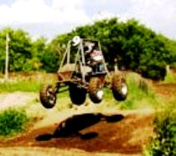
SAE Road Show II
Mini Baja

Slide 2

BRAKE SYSTEMS 101
Energy Conversion Management
Presented by Paul S. Gritt

Slide 3
Topics To Be Presented
The Basic Concepts
Hydraulic layouts
Component functions
Brake Balance
Stopping Distance and Fade
Formula SAE vs. Mini Baja
Lessons Learned
The Rules
Questions

Slide 4
The Basic Concepts
Kinetic energy = heat
F = ma
Newton is always right!
Do the calculations first
When all else fails see rule 3.

Slide 5

Energy Conversion
The brake system converts the kinetic energy of vehicle motion into heat
Notes:
The brake system converts the kinetic energy of the moving vehicle into heat.
The brake engineer has two challenges:
1. Create enough deceleration to stop the car as quickly as the driver wishes.
2. Manage the resulting heat energy so as not to damage the brake system or the rest of the vehicle.

Slide 6

Energy Conversion
A vehicle weighing 290 kg. (639 lbs.)
At 90 kph (55.9 mph) has kinetic energy of:
Stopping the vehicle at .9G takes 2.9 Seconds
This is equal to 31 kilowatts (42 HP).
OR 90,770 N-M.
Notes:
The equation for the energy conversion is very simple as you can see.

Slide 7
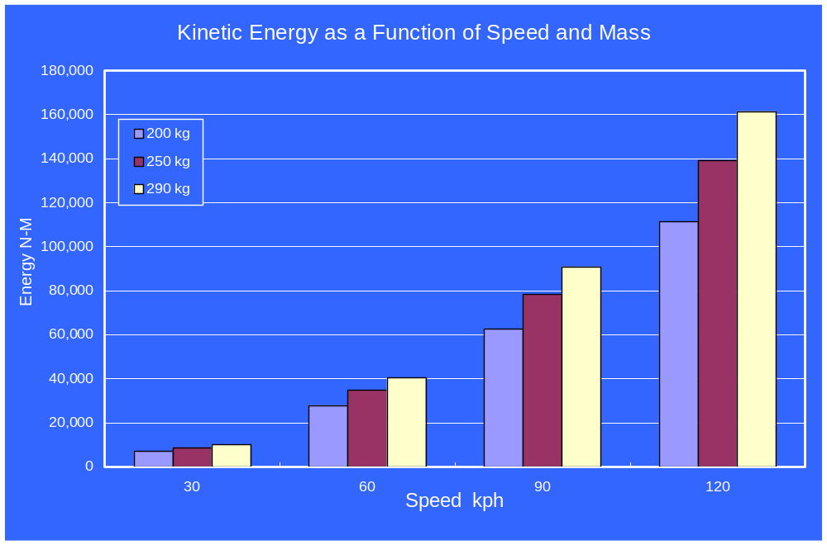
Notes:
Since the total kinetic energy of a moving vehicle is a function of the square of the speed, the speed from which you wish to stop a vehicle is much more important than the mass of the vehicle.
When selecting a brake system the performance of the powertrain must be taken into consideration.

Slide 8
F = ma
The Key Question!
How do you calculate F?

Slide 9
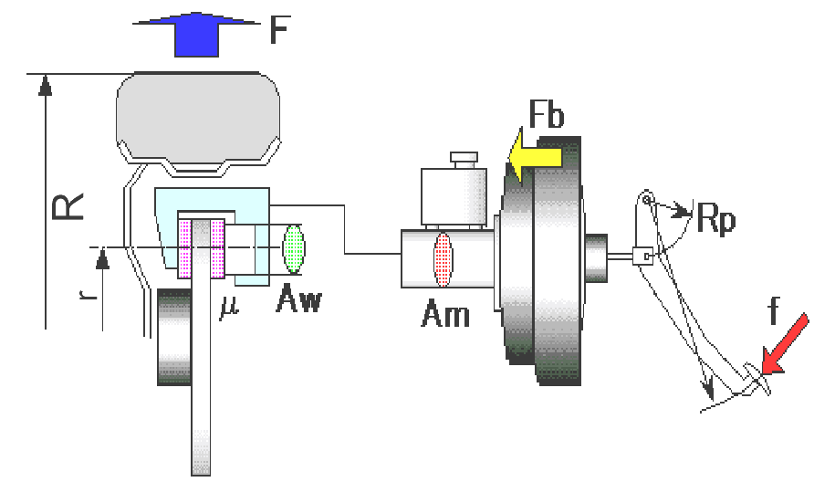

Basic System Model
Brake Force
Notes:
Brake Force Calculation Symbol Key
Using this basic model you can calculate the
brake force at each wheel of a vehicle F.
f is the force applied by the driver’s foot
Rp is the pedal lever ratio
Fb is the booster assist force
Am is the area of the master cylinder
Aw is the area of the front caliper piston
µ is the coefficient of friction of the lining
2 because there are 2 linings in a caliper
r is the effective radius of the caliper
R is the loaded radius of the tire.

Slide 10
Hydraulic System Configurations
There are two layouts of hydraulic brake systems used in cars and light trucks.
Front/Rear hydraulic split:
Also called axle by axle, vertical, and some times “black and white”.
Diagonal Split:
Also called criss-cross.
The type of split is only significant in the event of a hydraulic system failure.
Notes:
Lets look at the hydraulic circuits used in modern passenger cars and light trucks.
Typically rear wheel drive cars and trucks have front/rear split systems. Front wheel drive cars have diagonally split systems.
The front suspension design of front wheel drive vehicles, (small positive or a negative scrub radius) allows the use of diagonal split hydraulic systems.

Slide 11
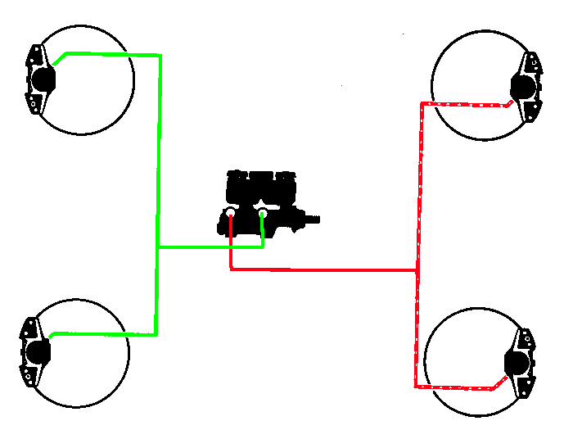
Front/rear Hydraulic Split
Primary System
Front Axle
Rear Axle
Secondary System
Notes:
This is a diagram of a basic front-rear split hydraulic system.
Notice that there is one line from the master cylinder to the rear axle brakes and one line to the front axle brakes.
You might also notice that the line to the front brakes comes from the “rear” outlet of the master cylinder. This can cause a lot of confusion when discussing brake systems.
The solution to this Symantec problem is to use the technically correct terms for describing master cylinder circuits.
The hydraulic circuit that is closest to the open end of the master cylinder(also closest to the power brake unit and the driver) is always referred to as the “primary” circuit. The circuit closest to the closed end of the master cylinder casting is always referred to as the secondary circuit. This nomenclature should be used regardless of how the hydraulic lines of a vehicle are connected to the rest of the brake system.

Slide 12
Diagonal Split System
In a diagonal split system, one brake line is run to
each rear brake and one to each front brake.
The connections are such that the left front and the right rear brake are on one circuit and the right front and left rear are on the other circuit
Notes:
Diagonal split hydraulic systems are commonly used on front wheel drive vehicles. This is primarily because under unladen or driver only conditions there is so little weight on the rear axle that the vehicle would not be able to meet the legally required stopping distances with only the rear brakes.
Rear brake only stopping distance can be a problem with rear wheel drive pickup trucks also. They must use a front rear split because the front suspension design of these vehicles (large positive scrub radius) would produce unacceptable pull during a stop with a 1/2 system failure and a diagonally split hydraulic system.

Slide 13
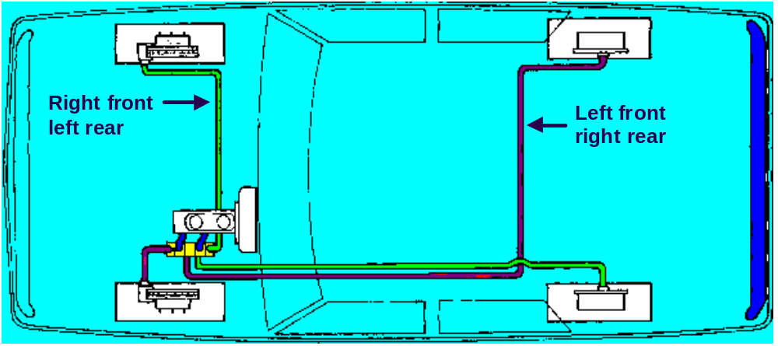
Typical Diagonal Split System
Notes:
Since there is one line to each brake, a diagonal split system requires more tubing and more connections than a front rear split system.
Also the distinction between front and rear hydraulic circuits or master cylinder outlets is meaningless.

Slide 14
Brake Component Function

Slide 15
Four Sub-systems
Actuation sub-system
Foundation sub-system
Parking brake sub-system
ABS & ESP (electronic stability
program) sub-system
Notes:
The overall braking system of a modern vehicle is usually divided into four sub-systems:
During this class I am going to cover the actuation and foundation sub-systems.
In order to understand the function of ABS/ESP systems a basic understanding of the foundation brake sub system and the actuation sub-system are required in any case.

Slide 16
Actuation Sub-system
Brake Pedal
Master Cylinder
Proportioning Valves
Brake Lines
16

Slide 17
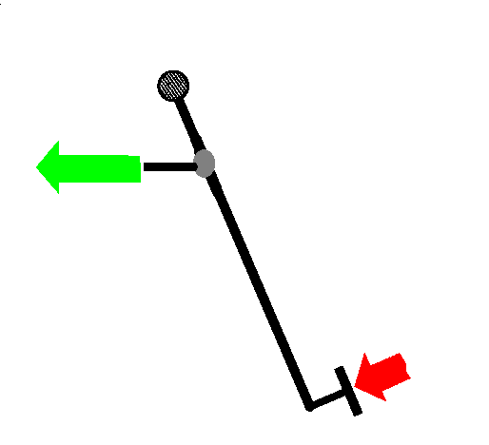
The Brake Pedal
Output to master cylinder
4:1 Nominal
Pedal Ratio
400 N and 36 mm
Driver Input
100 N and 144 mm
Notes:
The Brake Pedal
The brake pedal is a simple lever. The fulcrum is at the top of the brake pedal arm, the input is on the opposite end, and the output rod is somewhere in between. For example, a driver input force of 100 N is multiplied by a 4:1 ratio into 400 N of output force. This output force becomes the input force for the power brake unit or booster. The travel of the drivers foot will be 4 times the travel of the booster input pushrod.
Pedal ratios on most power brake vehicles today vary between 3:1 and 5:1

Slide 18
Master Cylinders
A master cylinder is just a simple piston inside a cylinder
Input Force
Output Pressure
Notes:
The master cylinder converts the input force into hydraulic pressure. If the master cylinder is not operating properly, or if there has been loss of fluid, the pressure created in the master cylinder which should be transmitted to the wheel cylinders will not be adequate and braking power will be reduced significantly.
Master cylinders in cars prior to 1967 contained a single piston. Reserve fluid in these early models was stored in the master cylinder’s single reservoir. Braking force was transmitted directly to each of the four wheel cylinders.
All passenger cars sold in the U.S. after January 1, 1967 employ dual master cylinders. One piston independently serves one half of the brake systems and one piston independently serves the other half. Added safety was the principal reason for changing to dual master cylinders. With the dual design, when there is a failure in either of the two hydraulic systems, the remaining system can still stop the car when force is applied at the brake pedal.

Slide 19
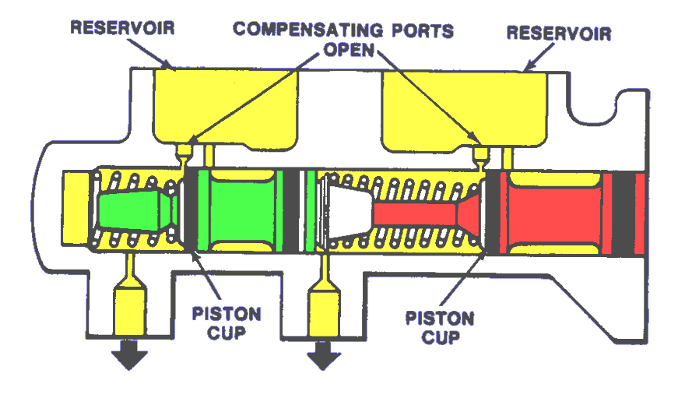
M/C Unapplied
Notes:
When the brake pedal is in the released position, both pistons in a dual master cylinder are retracted. Each piston has fluid in front of it; each is open to its own compensating port. The fluid in the master cylinder and throughout the brake system is at atmospheric pressure.

Slide 20
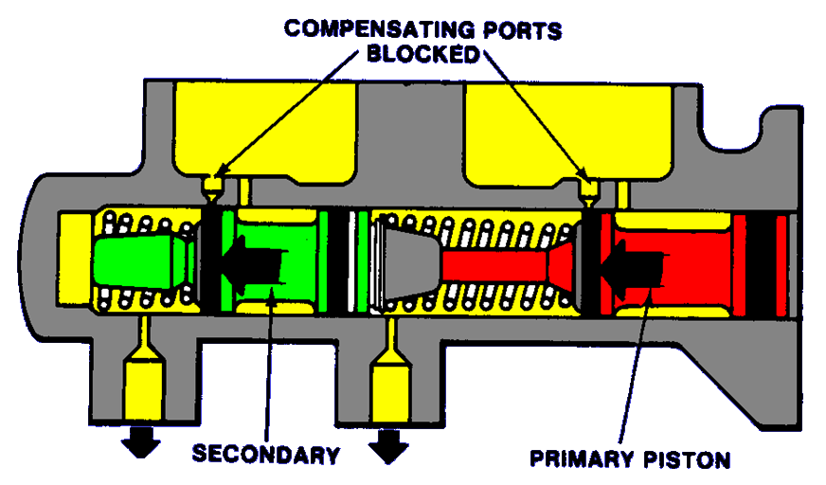
M/C Applied
Notes:
Depressing the brake pedal causes both the primary and the secondary pistons to move forward and exert hydraulic pressure independently in the primary and secondary brake systems. When the primary piston moves forward, it blocks oft the compensating port and seals the fluid in front of it. As it continues to advance, it transmits fluid pressure to the primary hydraulic circuit as well as to the secondary (slave) piston. The secondary piston moves forward and blocks off its compensating port. It seals the fluid in front of it and transmits fluid pressure to the rear wheel cylinders.
When the brake pedal is released, the master cylinders coil springs retract the pistons quickly. However, the wheel cylinder brake shoe return springs retract their pistons more slowly. The fluid returns more slowly as a result, and pressure in the master cylinder drops until it is lower than that in the reservoirs. Atmospheric pressure on the reservoir fluid pushes the fluid through the filler ports, past the cups, to equalize pressure in the piston chambers.

Slide 21
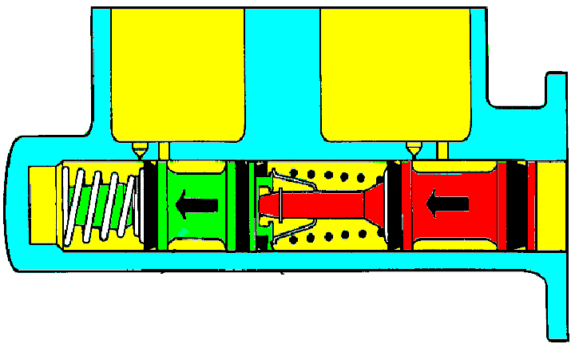
Primary System Failure
Pressure for Normal Secondary System Function
Operated Mechanically
Bottoms Against
Secondary Piston
Notes:
Loss of brake fluid through leaks or broken brake lines can be a cause of brake failure. One half of the system is lost when the primary system fails. However, initial pedal movement causes the unrestricted primary piston to bottom against the secondary piston. Continued movement of the pedal moves the secondary piston mechanically to displace fluid and transmit pressure to actuate the brakes connected to the secondary system.
The pedal travel will increase by a large amount. To activate the remaining system the brake pedal must be pushed well past the position for normal braking. Pumping the pedal will do no good and will not activate the second hydraulic system.

Slide 22
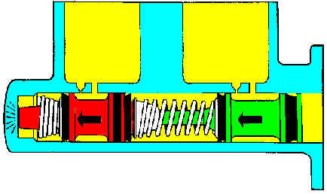
Secondary System Failure
Bottoms at End of Cylinder Bore
Pressure for Normal Primary System Function
Notes:
Similarly, if there is a failure in the secondary system. Initial pedal movement, in this case, causes the unrestricted secondary piston to bottom against the forward wall of the master cylinder. Movement of the primary piston displaces fluid and transmits hydraulic pressure to actuate the brakes connected to the primary system.
Again the pedal travel will increase by a large amount. To activate the remaining system the brake pedal must be pushed well past the position for normal braking. Pumping the pedal will do no good and will not activate the second hydraulic system.

Slide 23
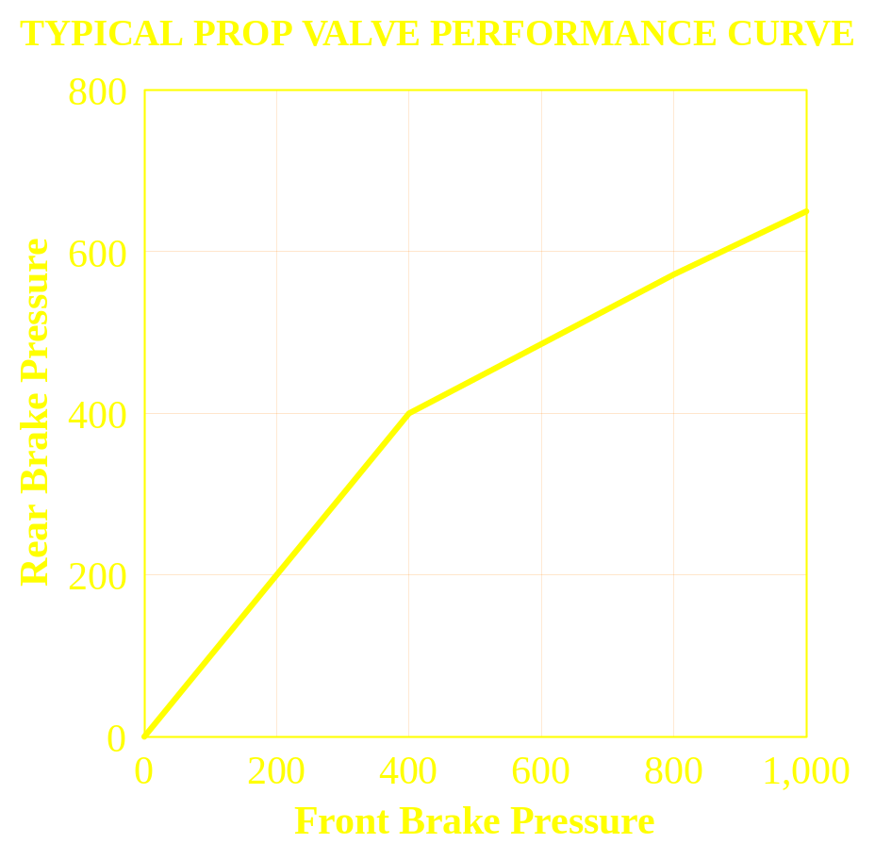
Proportioning Valves
Reduce the pressure to the rear brakes
Diagonal systems require two
Split and slope are changed to create proper balance
Split Point
Slope
Hard Stops
Notes:
Fixed Proportioning valve
A fixed proportioning valve reduces the pressure increase to the rear brakes above a pre-determined pressure called the “split point.” The rate of pressure reduction is called the prop valve "slope". the valve must be located between the master cylinder and the rear brakes.
Typical slope values are: 0.27, 0.34 0.43 and 0.59.
Split points usually run between 17 bar (250 psi) and 35 bar (500 psi). Higher values of split point are available.
Valves with adjustable split points are available from several after market specialty suppliers for racing applications.

Slide 24
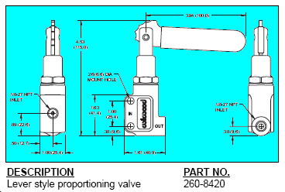
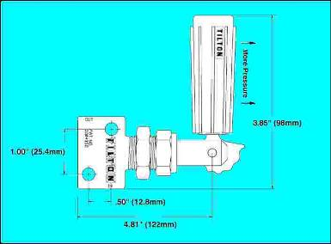
Adjustable Proportioning valves
Wilwood
Tilton
Only the split points are adjustable

Slide 25
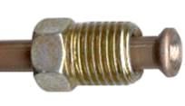
Brake Lines
Double wall steel tubing (Bundy Tubing) is industry standard.
3/16” o.d. is standard size.
Very robust, can take a lot of abuse
Use SAE 45° inverted flare (J533 and J512) joints if you can.

Slide 26
Foundation Brake Sub-system
Disc Brakes
Linings

Slide 27
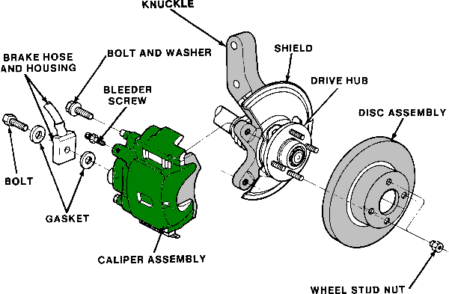
Front Disc Brake
Notes:
A typical disc brake corner has a caliper and a rotor. The rotor turns with the wheel and the caliper is fastened to the suspension.
Most of the energy that is converted into heat goes into the rotor.
One of the key factors in selecting the correct size brake system for a given application is to balance the thermal mass and surface area of the rotors with the amount of energy that they are going to have to handle.
Increasing thermal mass by making the rotor thicker and/or larger in diameter will reduce the temperature rise that results from a given energy input. This most directly effects the peak temperatures a the end of a fade sequence.
Increasing the surface area of a rotor, by making it larger in diameter and/or adding more fins will reduce the steady state temperature that it reaches during prolong braking such as a long mountain decent or long periods of stop and go driving. Increasing the diameter is much more affective than changing the fin configuration.

Slide 28
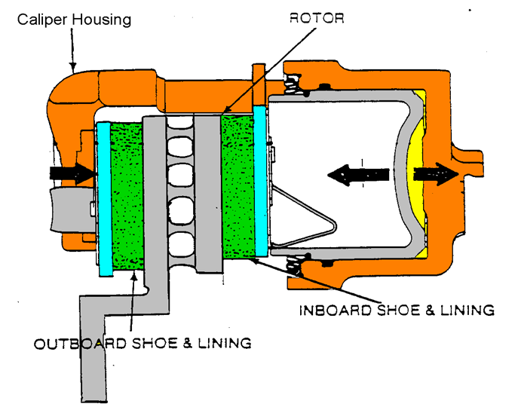
Front Disc Brake
Notes:
A typical brake caliper can be thought of as nothing more than a hydraulic C-clamp.
The diagram shows the brake fluid pressure pushing the piston to the left which pushes the inboard shoe and lining against the rotor. At the same time the caliper housing moves to the right and pushes the outboard shoe and lining against the other side of the rotor to create a clamping force. (this is where the “2” in the system equation comes from)
In order to calculate the amount of clamping force generated in the caliper, the incoming pressure is multiplied by the area of the caliper piston. As an example, 40 bar (580 psi) into the caliper would push against the back of a 57mm piston. this pressure is also pushing the back of the caliper bore in the other direction with an equal force. Therefore the total clamp force on the rotor will be equal to two times the area of the 57mm piston. Working the numbers reveals that 40 bar will generate 20,416 Newton's (4640 lbs..) of clamp force (40 bar x 25.52 cm2 x 2).
The two linings rub on the rotor which is turning with the wheel. The friction produces torque which slows the wheel.

Slide 29
Brake Linings
Brake linings are probably the most mis-understood part of a brake system.
The output of any brake is directly related to the coefficient of friction (µ) between the lining and the disc or drum.
The challenge is knowing what the instantaneous value of µ is during any given stop.
Any design calculations you do, go right out the window if the lining you use does not have the µ value you assumed.
Notes:
We all talk about lining µ but we really mean the effective coefficient of the “friction couple” between the lining and rotor surfaces. Any change in either of these parts can and will affect the resulting friction.
Changing the machining finish on a rotor from ground to turned could result in a different effective friction value for many hundreds of stops.
The instantaneous value of µ changes during a single stop.
This means that when you compare linings you must use the same dyno test and the same sections of the test. It also means that you cannot only look at average values for a whole stop but must look at the “in-stop”data.

Slide 30
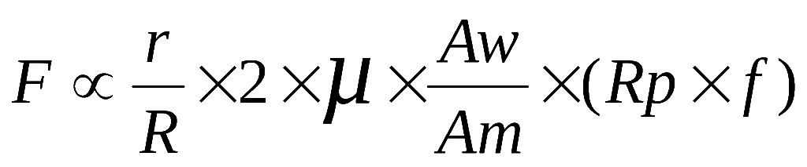
Brake Linings
Remember the equation for a disc brake
The best method for determining the actual value of µ for a given lining is from a dynamometer test.

Slide 31
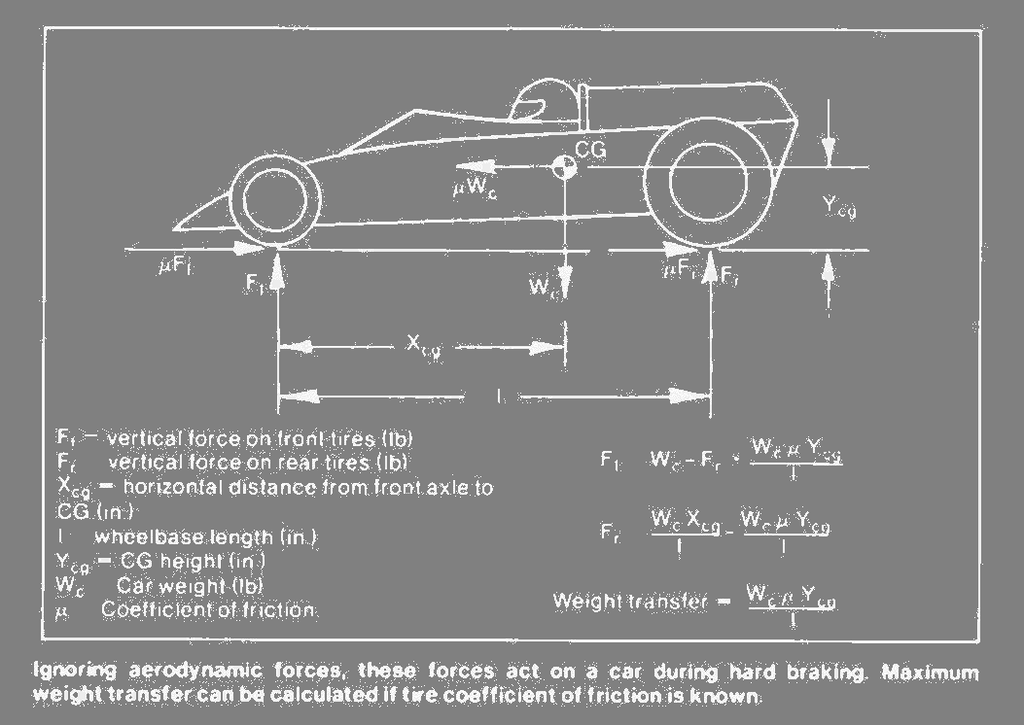
Brake Balance
Notes:
Brake balance is the science of the relationship between the vertical forces on the front and rear tires and the torque applied by the front and rear brakes at any given instant.
The first question you may ask is what difference does it make? and why should I care??
To answer this lets look at what happens to a vehicle when the wheels at one end of a vehicle lock before those at the other end.

Slide 32
Both Front Wheels Locked:
You can’t steer
The vehicle goes straight
OK, if you must hit something
Not good if you are on a curved road
Notes:
Since the occupant protection and crash energy management features of a vehicle are optimized for a frontal impact, it is always better to hit something head on, if you can’t avoid the impact, then sideways.

Slide 33
Both Rear Wheels Locked:
The front wheels track straight ahead
Then the rear wheels deviate to the side
Until the vehicle can’t track straight any longer and the rear starts to spin around the front
Notes:
We have all been told at one time or another; "steer in the direction of the skid." What we should have been told is; "steer in the direction that the rear of the car is skidding".
In the real world if a vehicle has both rear wheels locked at a relatively high speed, the rear end will come around so fast that no one but the most skilled race drivers will be able to maintain control.
If you watch auto racing, you may observe that when a driver starts to loose the back end of the vehicle they will lock up all four wheels and just ride it out. They do this because if you release the brakes when the vehicle is skidding it will fly off in what ever direction the front wheels are pointing.

Slide 34
µ vs. % Wheel Slip
Typical Dry Surface
1
0.9
Braking
0.8
0.7
0.6
Mu (Deceleration)
0.5
0.4
Steering
0.3
0.2
0.1
0
0
10
20
30
40
50
60
70
80
90
100
% Wheel Slip

Slide 35
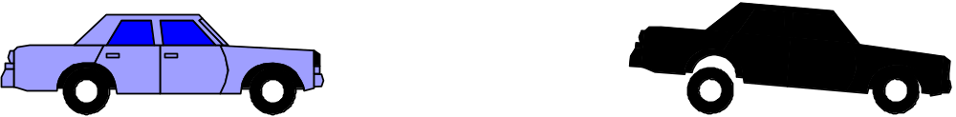
Front Lock
If there is more front brake torque than dynamic front weight
Brake torque
distribution
Dynamic weight
distribution
20%
80%
40%
60%
The front wheels will lock up before the rears

Slide 36
Rear Lock
If there is more rear brake torque than dynamic rear weight;
Brake torque
distribution
Dynamic weight
distribution
40%
60%
20%
80%
The rear wheels will lock up before the fronts

Slide 37
Optimum Braking
Optimum braking is achieved when brake torque distribution matches dynamic weight distribution
No Braking
Hard Braking
40%
20%
60%
80%
Weight Distribution

Slide 38


Calculating Dynamic Weight Transfer
Notes:
W_{df} = Front dynamic weight W_{t} = Total vehicle weight (mass)
Ht_{cg} = Height of the center of gravity Wb = The wheebase
D = Deceleration W_{fs} = Static front weight
The dynamic weight on the front tires W_{df} can be calculated by taking the sum of the moments about the front tire to road contact point.
As you can see from this equation the front dynamic weight is equal to the front static weight W_{fs} plus the product of the total vehicle weight W_{t} times the height of the C.G. (Ht_{cg}) divided by the wheelbase (Wb) and multiplied by the deceleration (D).
Then, of course, the dynamic rear weight is just the total vehicle weight minus the front dynamic weight.
Now all you have to do is design a brake system that has a front to rear torque distribution that changes with vehicle deceleration.
The proportioning valve reduces the pressure to the rear brakes above a certain pressure to partially compensate for the dynamic weight shift.
Naturally there will be more deceleration at higher pressures since the total torque of the front and rear brakes will be higher and the mass of the vehicle has not changed. This brings us back to go old F=MA.

Slide 39
Ideal Vs Actual Torque
Ideal
60/40 Actual
70/30 Actual
0.8
0.9
1.0
1.1
0.7
0.6
Rear Torque
0.5
0.4
0.3
With a prop valve
0.2
0.1
0.0
Front Torque
Notes:
Using the weight transfer equation you can calculate the normal forces on the front and rear tires for any deceleration.
Then multiplying by the tire to road coefficient of friction and the radius of the tire, you can calculate the front and rear brake torque required for perfect balance.

Slide 40
Stopping Distance
Does not Depend on:
  Type of brakes
  Size of brakes
Does Depend on:
  Tire to road friction
  Vehicle balance
  Skill of driver
  System Reaction Time
Notes:
Vehicle balance:
Since the highest deceleration is achieved when all four wheels are just about to skid, stopping distance is critically dependant on front to rear balance.
Driver Skill
Driver skill effects stopping distance because in a non-ABS vehicle the test driver must obtain the highest possible decel without locking any wheels. For a given vehicle balance the better driver will always get the shortest distance. This indirectly explains one of the biggest benefits of ABS. Under emergency braking conditions ABS makes all of us Mario Andretti as far as braking skill is concerned.
Measuring Method:
How you measuring stopping distance has an effect on the numbers you get. According the the procedures in MVSS-135 and ECE-13, stopping distance is measured starting from the initial application of force to the brake pedal. For the vast majority of vehicles this means that the measuring systems are triggered off the stop lamp switch circuit.
Some magazines use a device that starts to measure when vehicle deceleration is detected. The difference between these two methods can be 20-30 feet at 60 mph.

Slide 41
µ vs. % Wheel Slip
Typical Dry Surface
1
0.9
Braking
0.8
0.7
0.6
Mu (Deceleration)
0.5
0.4
0.3
0.2
0.1
0
0
10
20
30
40
50
60
70
80
90
100
% Wheel Slip

Slide 42



Brake Fade
Brake fade is the loss of performance resulting from the lining friction decreasing as the lining and rotor or drum rises in temperature
Notes:
When linings get hot they not only change in friction value but they also usually increase in compressibility. As a result during a series of hard stops when brake temperatures increase there will be an increase in the amount of fluid required to reach a given pressure as well as an increase in the amount of pressure required to produce a given torque
Dynamometer testing is a very good way of measuring the fade performance of linings.
After you have dyno fade data you need to plug the information back into the basic equations we have talked about to see what that means to the whole vehicle.
Remember to check front to rear balance.
Disc brakes are less susceptible to fade than drum brakes. This is one of the reasons that drum brakes are no longer used on the front of road vehicles.

Slide 43
Formula SAE vs.
Mini Baja
The brake system design must match the vehicle objectives

Slide 44
Formula SAE
Absolute reliability
High Speeds
Maximum possible decel without locking
Consistent balance with changing temperatures
Mini Baja
Absolute reliability
Low Speeds
Very hostile environment
Brake must work when wet and muddy

Slide 45
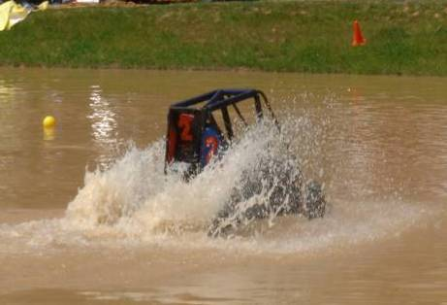
Mini Baja, Hostile Environment
Will your master cylinder fill up with water?
How does you brake lining work when it is wet?

Slide 46
Lessons Learned

Slide 47
Don’t Do Something Because:
The other guys do it.
All the race cars have it.
It looks really cool

Slide 48
Design to a Specific Objective:
Do the math first
Verify your assumptions
Take the easy solution (KISS)

Slide 49
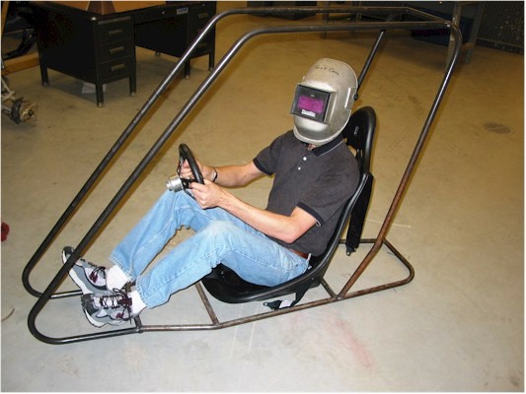
Lessons Learned
Lesson Number 1 - Keep it SIMPLE

Slide 50
Lessons Learned
Lesson Number 2 - Keep it light; but not too light.
90% of the braking energy goes into the rotor
If the rotor is too light it gets very hot
If the temperatures get too high very nasty things
can happen.

Slide 51
Too light
2006 DCAE program involved a Hemi powered Grand Cherokee.
One team used much smaller rear brakes and rotors to save a few pounds on a 3200 lb vehicle with 500 hp.
The vehicle went off the end of the main straight at over 100 mph on the third lap because of brake failure.

Slide 52
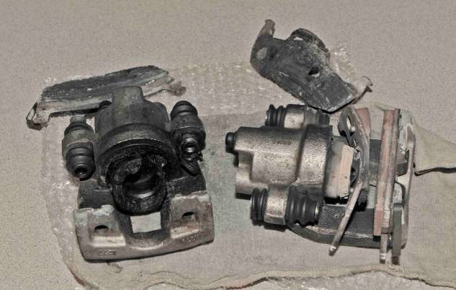

Slide 53
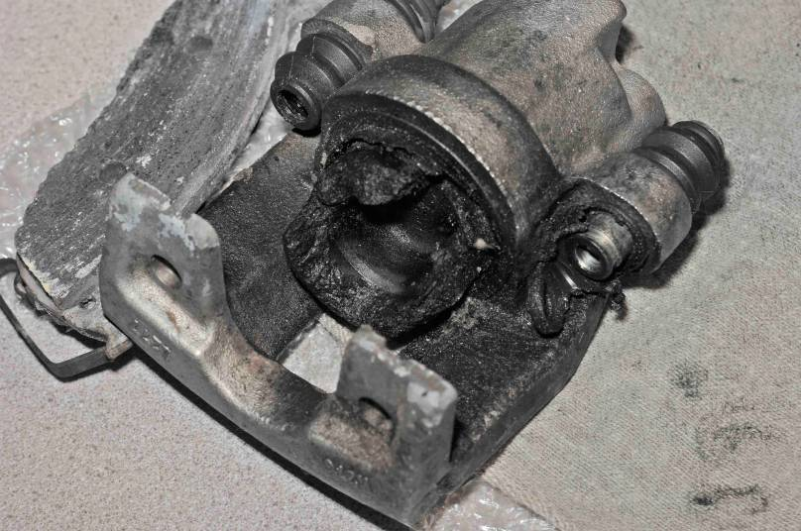

Slide 54
Lessons Learned
Lesson Number 3 - Packaging and Integration drive 90% of design
Lesson Number 4 - Read the rules
Lesson Number 5 - Allow enough time for details and testing

Slide 55
Brake rules
The car must have four wheel brakes operated by a single control.
It must have two independent hydraulic circuits with independent fluid reserves.
The brake system must be capable of locking all four (4) wheels, and stopping the vehicle in a straight line
The braking systems must be protected with scatter shields from failure of the drive train (FSAE only)
A brake pedal over-travel switch must be installed. This switch must kill the ignition and cut the power to any electrical fuel pumps. (FSAE only)
The car must be equipped with a red brake light that illuminates when ever the brakes are applied

Slide 56


Any Questions

